Slide 1
Knowledge Sharing and Collaborative Network Structures at XYZ*
Created by Young Hun Ji
young.ji@aalto.fi
Department of Management Studies
Aalto University
School of Business
January 2020
* Note: Company name has been anonymized for confidentiality purposes

Slide 2
Today’s agenda
Research background: i.e., intent of survey, the importance of knowledge sharing and collaborative networks, list of data collected, and our investigative framework
Descriptive statistics I: Summary of descriptive statistics for each of the surveyed variables
Key takeaways I: i.e., answers to the question of “What factors shape the behaviors that facilitate knowledge sharing and collaboration between employees?”
Descriptive statistics II: Summary of descriptive statistics for each of the computed network metrics
Key takeaways II: i.e., answers to the question of “What factors shape the relationships that facilitate knowledge sharing and collaboration between employees?”

Slide 3
Research background
The overarching aim of this survey was to better understand knowledge sharing and collaborative structures between employees at XYZ.
Our survey was designed to explore various inter-related questions such as:
How frequently do employees engage in knowledge sharing and other related behaviors? What kinds of psychological and work-related factors are related to such behaviors?
How does work-related knowledge and information flow between XYZ’s employees? Are there patterns regarding who sends/receives information to/from whom?
Who is central in XYZ’s collaborative network? Who occupies brokerage and other strategically advantageous network positions, and what kinds of psychological and organizational factors shape individuals’ network positions?

Slide 4
Research background (cont.)
Knowledge sharing and collaborative relations between employees are important because…
For organizations:
Individual and group performance
Change management
Employee retention
Innovation and creativity
Conflict dynamics
Newcomer onboarding
Perceptions of employees, teams, and organizations
Spread of information (real and imagined), ideas, behaviors, culture
For individuals:
Positive career outcomes: compensation, promotions, assignments
Become a magnet for opportunities
Access to information and resources
Ability to get things done and perform
Innovation and creativity
Control of resources
Source of influence and power
Status/Visibility

Slide 5
Research background (cont.)
To examine knowledge sharing and collaboration at XYZ, we gathered data regarding the following:
Behaviors that facilitate knowledge sharing and collaboration
Specifically, we measured knowledge sharing and networking behaviors.
To do this, we asked individuals to “self-report” his/her frequency of knowledge sharing and networking behaviors.
Social relations that facilitate knowledge sharing and collaboration
Essentially, we asked people, “To whom do you reach out to for work-related information or advice?” which allowed us to map the instrumental/collaborative network ties between employees.
We also asked people, “Within the company, who do you consider as friends?” which allowed us to map a “friendship network.”
This sociomatrix data was then used to compute other network-related metrics such as centrality and brokerage.

Slide 6
Research background (continued)
Additionally, we gathered data regarding various other factors that may shape knowledge sharing behaviors and collaborative structures between employees.
Specifically, we measured:
Psychological factors such as self-interest and self-perceived power and status
Strategic orientations regarding the social network process of brokerage (e.g., the tendency to introduce one’s contacts to each other versus keeping them apart from each other)
Organization factors such as organizational level (i.e., title) and tenure

Slide 7
Research background (cont.)
Below is the full list of the data we collected:
Behaviors:
Knowledge sharing
Networking behavior
Psychological factors:
Sense of power
Self-perceived status
Self-interest orientation
Other-interest orientation
Strategic orientations toward brokerage:
Tertius iungens orientation
Tertius gaudens orientation
Tertius conduit orientation
Sociomatrix data:
List of persons whom one goes to for advice or other work-related issues.
List of persons considered as a friend
This data is used to compute various network metrics such as Centrality, Reach, Density, and Brokerage.
Organization factors:
Organizational level (i.e., title)
Firm tenure
Work characteristics (e.g., job complexity)
Demographics:
Age, gender, and education level

Slide 8
Research background (cont.)
Broadly, our investigative framework looked something like this:
Inputs
1. Psychological variables: Power, Status, Self-interest orientation, and Other-orientation
2. Strategic brokering orientations: Tertius iungens orientation (TIO), Tertius gaudens orientation (TGO), and Tertius conduit orientation (TCO)
3. Organizational factors: Organizational level and tenure
Outputs I: Behaviors
Knowledge sharing
Networking behavior
Outputs II: Social relations
Degree centrality
Reach
Density
Brokerage

Slide 9
Next, let’s look at the descriptive statistics for each of the surveyed variables

Slide 10
First, let’s talk about sample characteristics, i.e., “about you”
Number of respondents: N = 125
Gender: 88 women (70.4%) and 37 men (29.6%)
Organization level:
32 (25.6%) in entry level
79 (63.2%) in mid level
9 (7.2%) in senior level
5 (4.0%) in executive level
Tenure: Mean = 6.56 years, S.D. = 5.61 years, Range = 2 – 33 years

Slide 11
Second, let’s talk about work characteristics, i.e., “about your job”
Information availability (scale of 1 to 5):
Sample item: “All the information I need is available even without a special request”
Mean = 3.02, S.D. = .80, Range = 1.00 – 5.00
Job complexity (scale of 1 to 5):
Sample item: “The job requires that I only do one task or activity at a time.” (reverse scored)
Mean = 4.22, S.D. = .75, Range = 1.50 – 5.00
Information processing (scale of 1 to 5):
Sample item: “The job requires me to monitor a great deal of information.”
Mean = 4.14, S.D. = .78, Range = 1.00 – 5.00
Problem solving (scale of 1 to 5):
Sample item: “The job involves solving problems that have no obvious correct answer.”
Mean = 3.76, S.D. = .94, Range = 1.25 – 5.00

Slide 12
Knowledge sharing
What it measures: the frequency with which one shares various types of knowledge with his/her colleagues.
Survey question:
“On average, how often did you share each type of knowledge during the project with your work colleagues?
(a) General overviews (e.g., project goals, milestone estimates, or member responsibilities)
(b) Specific requirements (e.g., numerical projections, market forecasts, or order requests)
(c) Analytical techniques (e.g., statistical tools, detailed methods, or testing procedures)
(d) Progress reports (e.g., status updates, resource problems, or personnel evaluations)
(e) Project results (e.g., preliminary findings, unexpected outcomes, or clear recommendations)”
Response scale is from 1 to 5

Slide 13
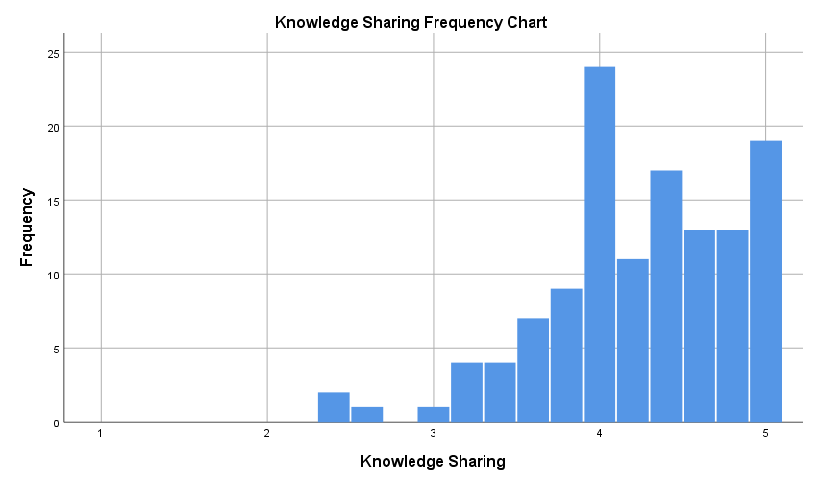
Knowledge sharing (continued)
Means and standard deviations
Org level | N | Mean | S.D.
Entry level | 32 | 4.03 | 0.71
Mid level | 79 | 4.29 | 0.52
Senior level | 9 | 4.29 | 0.43
Executive level | 5 | 4.64 | 0.22
All | 125 | 4.24 | 0.58
ANOVA test reveals marginally significant differences in knowledge sharing across organizational levels (p = .06), i.e., higher knowledge sharing at higher org levels.
Tenure is not significantly related to knowledge sharing.

Slide 14
Networking behavior
What it measures: the extent to which one engages in networking behaviors with his/her colleagues
Survey question:
“To what extent have you…
…started conversations with people from different segments of the company?
…tried to socialize with people who are not in your department/unit?
…tried to get to know as many people as possible in other sections of the company on personal basis?”
Response scale is from 1 to 5

Slide 15
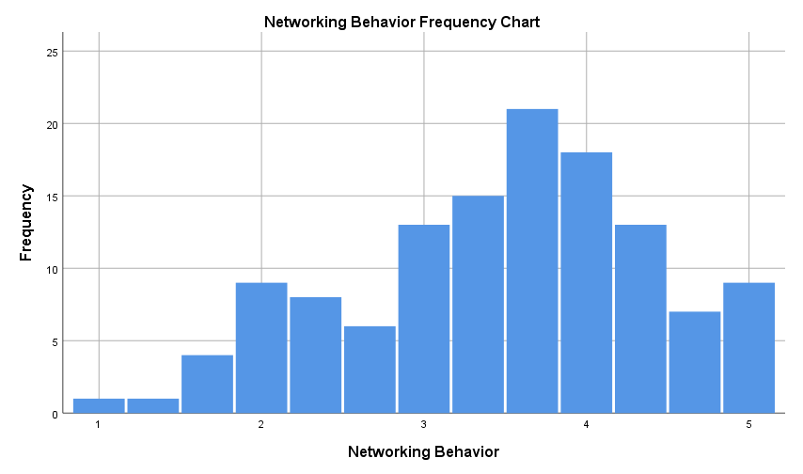
Networking behavior (continued)
Means and standard deviations
Org level | N | Mean | S.D.
Entry level | 32 | 3.21 | 0.93
Mid level | 79 | 3.53 | 0.92
Senior level | 9 | 3.70 | 0.99
Executive level | 5 | 3.67 | 1.03
All | 125 | 3.47 | 0.93
ANOVA test reveals no statistically significant differences in networking behavior across organizational levels.
Tenure is not significantly related to networking behavior.
Next up: Psychological factors...

Slide 16
Power
What it measures: the extent to which one feels influential in his/her work environment
Survey question (abridged):
“Recently, at work, I have felt that…
…I can get people to listen to what I say
…I can get people to do what I want
…if I want to, I get to make the decisions”
Response scale is from 1 to 5

Slide 17
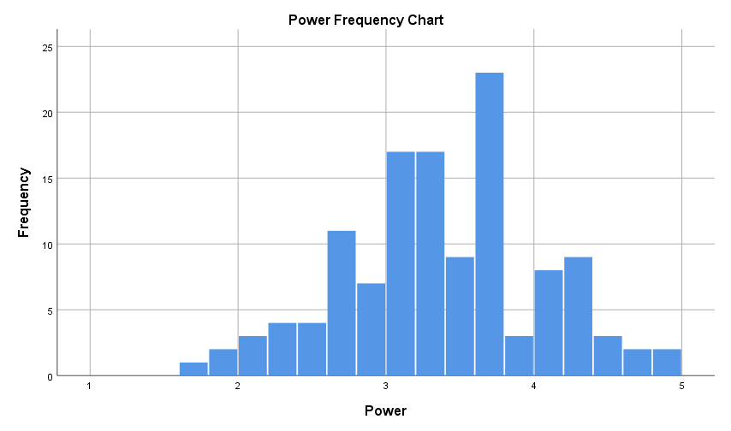
Power (continued)
Means and standard deviations
Org level | N | Mean | S.D.
Entry level | 32 | 2.94 | 0.59
Mid level | 79 | 3.42 | 0.61
Senior level | 9 | 3.82 | 0.44
Executive level | 5 | 4.35 | 0.58
All | 125 | 3.37 | 0.67
ANOVA test reveals statistically significant differences in power across organizational levels, i.e., greater sense of power at higher org levels.
Tenure is not significantly related to power.
Power is significantly related to networking behavior (r = .20, p < .05) but not knowledge sharing.

Slide 18
Status
What it measures: the extent to which one feels he/she possesses high status in his/her work environment
Survey question:
“Recently, at work, I have felt that…
… I have a great deal of prestige in my organization
… I possess high status in my organization
… I occupy a respected position in my organization
… I have a position of prestige in my organization
… I possess a high level of prominence in my organization”
Response scale is from 1 to 5

Slide 19
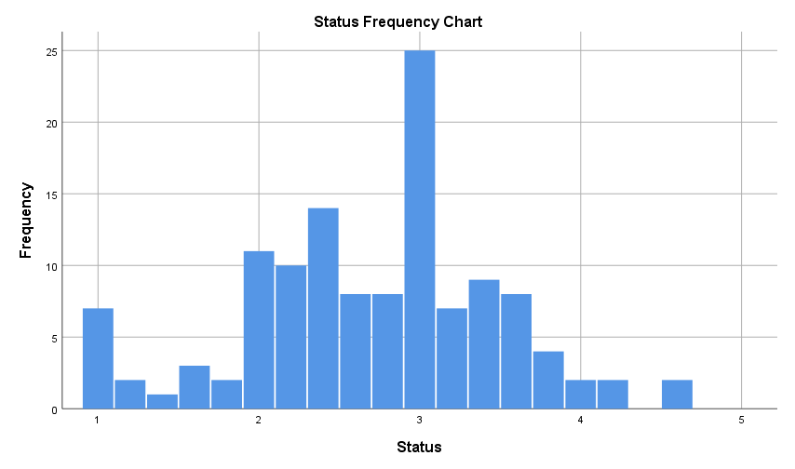
Status (continued)
Means and standard deviations
Org level | N | Mean | S.D.
Entry level | 32 | 2.39 | 0.72
Mid level | 79 | 2.70 | 0.75
Senior level | 9 | 3.13 | 0.30
Executive level | 5 | 4.00 | 0.60
All | 125 | 2.71 | 0.78
ANOVA test reveals statistically significant differences in status across organizational levels, i.e., greater status at higher org levels.
Tenure is not significantly related to status.
Status is not significantly related to knowledge sharing or networking behavior.

Slide 20
Self-interest orientation
What it measures: the extent to which one views his/her goals, aspirations, and desires as important
Survey question:
“At work…
…I am concerned about my own needs and interests
…my personal goals and aspirations are important to me
…I consider my own wishes and desires to be relevant”
Response scale is from 1 to 5

Slide 21
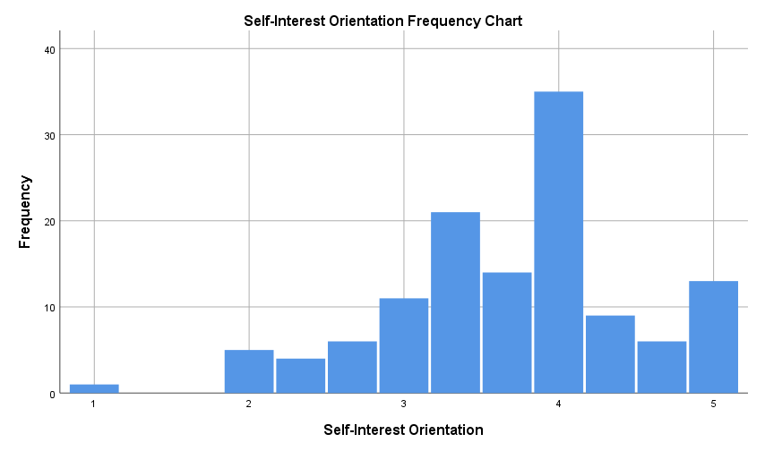
Self-interest orientation (continued)
Means and standard deviations
Org level | N | Mean | S.D.
Entry level | 32 | 3.74 | 0.89
Mid level | 79 | 3.72 | 0.80
Senior level | 9 | 3.52 | 0.53
Executive level | 5 | 3.60 | 0.55
All | 125 | 3.70 | 0.80
ANOVA test reveals no statistically significant differences in self-interest orientation across organizational levels.
Tenure is significantly, negatively related to self-interest orientation (r = -.19, p < .05).
Self-interest orientation is not significantly related to knowledge sharing or networking behavior.

Slide 22
Other-interest orientation
What it measures: the extent to which one views the goals, aspirations, and desires of his/her colleagues as important
Survey question:
“At work…
…I am concerned about the needs and interests of others such as my colleagues
…the goals and aspirations of colleagues are important to me
…I consider others’ wishes and desires to be relevant”
Response scale is from 1 to 5

Slide 23
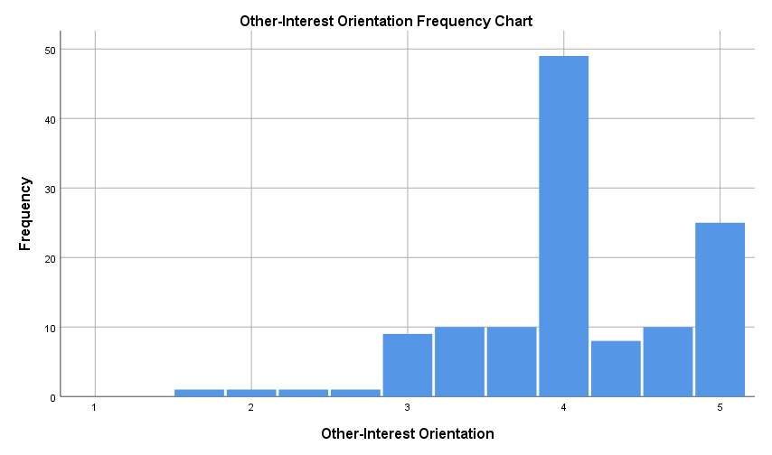
Other-interest orientation (continued)
Means and standard deviations
Org level | N | Mean | S.D.
Entry level | 32 | 4.23 | 0.61
Mid level | 79 | 3.93 | 0.71
Senior level | 9 | 4.22 | 0.47
Executive level | 5 | 4.67 | 0.41
All | 125 | 4.06 | 0.68
ANOVA test reveals statistically significant differences in other-interest orientation across organizational levels, i.e., higher other-interest orientation at higher org levels.
Tenure is not significantly related to other-interest orientation.
Other-interest orientation is significantly related to knowledge sharing (r = .43, p < .01) and networking behavior (r = .18, p < .05).
Next up: Strategic brokerage orientations...

Slide 24
Tertius iungens orientation
What it measures: the extent to which one tends to actively “join” network contacts whom may not yet know each other.
Survey question (abridged):
“At work…
…I introduce two people when I think they might benefit from becoming acquainted
…I will try to describe an issue in a way that will appeal to a diverse set of interests
…I forge connections between different people dealing with a particular issue
…I see opportunities for collaboration between people”
Response scale is from 1 to 5

Slide 25
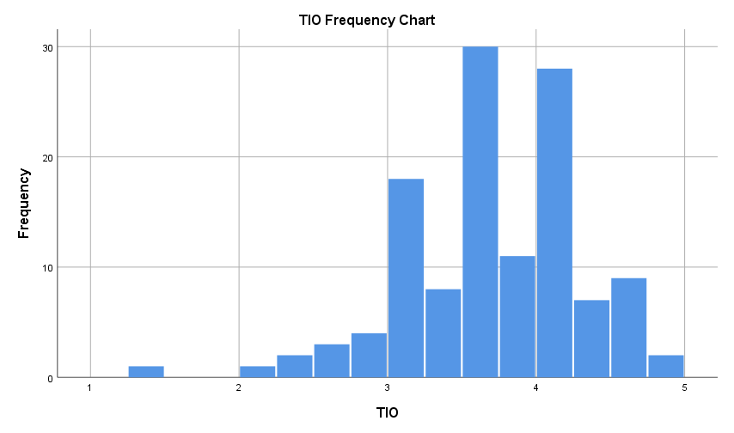
Tertius iungens orientation (continued)
Means and standard deviations
Org level | N | Mean | S.D.
Entry level | 32 | 3.52 | 0.69
Mid level | 79 | 3.70 | 0.59
Senior level | 9 | 3.65 | 0.39
Executive level | 5 | 4.30 | 0.40
All | 125 | 3.67 | 0.61
ANOVA test reveals no statistically significant differences in tertius iungens orientation (TIO) across organizational levels. Tenure is not significantly related to TIO.
TIO is significantly, positively related to power (r = .21, p < .05) and other-interest orientation (r = .18, p < .05) but not status or self-interest orientation.
TIO is also significantly, positively related to knowledge sharing (r = .32, p < .01) and networking behaviors (r = .34, p < .01).

Slide 26
Tertius gaudens orientation
What it measures: the extent to which one tends to actively “keep apart” network contacts whom may not yet know each other.
Survey question (abridged):
“At work…
…I seek to prevent my contacts from becoming too closely acquainted with one another
… I seek to control when and how different actors interact with each other
… Sometimes I aim to strategically undermine the relationships between my contacts
… I seek to gain control over acquaintances by keeping them apart”
Response scale is from 1 to 5

Slide 27
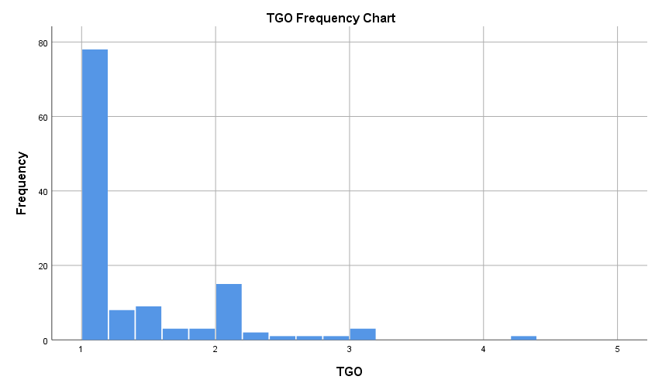
Tertius gaudens orientation (continued)
Means and standard deviations
Org level | N | Mean | S.D.
Entry level | 32 | 1.36 | 0.70
Mid level | 79 | 1.36 | 0.52
Senior level | 9 | 1.56 | 0.69
Executive level | 5 | 1.07 | 0.09
All | 125 | 1.36 | 0.57
ANOVA test reveals no statistically significant differences in tertius gaudens orientation (TGO) across organizational levels. Tenure is not significantly related to TGO.
TGO is significantly, negatively related to power (r = -.19, p < .05). But, it is not significantly related to status, self-interest orientation, or other-interest orientation.
TGO is not significantly related to knowledge sharing or networking behaviors.

Slide 28
Tertius conduit orientation
What it measures: the extent to which one tends to “channel/relay” resources between network contacts whom may not yet know each other.
Survey question (abridged):
“At work…
…I tend to take a role of a messenger who moves knowledge from one person to another
… Moving ideas between different groups is a critical aspect of my behavior
… When I have a choice I prefer to relay ideas between parties
… I seek to pursue objectives by moving information from one person to another”
Response scale is from 1 to 5

Slide 29
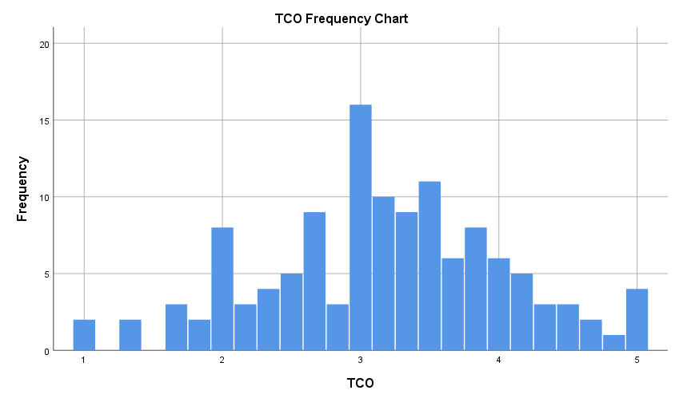
Tertius conduit orientation (continued)
Means and standard deviations
Org level | N | Mean | S.D.
Entry level | 32 | 2.73 | 0.94
Mid level | 79 | 3.33 | 0.80
Senior level | 9 | 3.04 | 0.93
Executive level | 5 | 3.73 | 0.42
All | 125 | 3.17 | 0.87
ANOVA test reveals statistically significant differences in tertius conduit orientation (TCO) across organizational levels, i.e., higher TCO at higher org levels. Tenure is not significantly related to TCO.
TCO is significantly, positively related to power (r = .20, p < .05), status (r = .23, p < .05), and other-interest orientation (r = .24, p < .01), but not self-interest orientation.
TCO is significantly related to knowledge sharing (r = .41, p < .01) and networking behaviors (r = .33, p < .01).

Slide 30
Takeaways I: Knowledge sharing & Networking behaviors
“Why do it?”: Knowledge sharing and Networking behaviors facilitate the transfer of important work-related information and other resources between individuals and are thus critically important for employee performance and organizational success.
“Who does it?”: Data revealed that…
Individuals at higher organizational levels scored (marginally significantly) higher on knowledge sharing behaviors. Perhaps this is due to their particular work demands, e.g., they do more leadership work that necessitates greater knowledge sharing.

Slide 31
Takeaways I: Knowledge sharing & Networking behaviors (cont.)
“Who does it?” (cont.): Data revealed that…
Individuals who scored higher on other-interest orientation scored higher on both knowledge sharing and networking behavior.
Furthermore, multiple regression analysis revealed that other-interest orientation significantly predicts knowledge sharing while controlling for organizational level and tenure:
Β = .40 (p < .001); F = 11.18 (p < .001); R² = .22, ΔR² = .16 (p < .001)
It appears that, generally, XYZ employees view engaging in knowledge sharing behaviors as being well-aligned with their colleagues’ work-related self-interests, goals, needs, and desires.
It is possible that other-interest orientation shapes networking behaviors, i.e., people who are concerned with others’ interests are more likely to socialize with others. It is also possible that this relationship is “flipped,” i.e., people who socialize with others in turn become more concerned with the interests of others.

Slide 32
Takeaways I: Knowledge sharing & Networking behaviors (cont.)
“Who does it?” (cont.): Data revealed that…
Individuals who scored higher on the tertius iungens orientation (TIO), i.e., tendency to “join” others who may otherwise be unfamiliar with each other, scored higher on both behaviors.
Similarly, individuals who scored higher on the tertius conduit orientation (TCO), i.e., tendency to “channel” resources between other people, scored higher on both behaviors.
Furthermore, multiple regression revealed that TIO and TCO predict both behaviors while controlling for org level and tenure.
TIO → Knowledge sharing: Β = .26 (p < .01); F = 5.46 (p < .01); R² = .12, ΔR² = .06 (p < .01)
TIO → Networking behavior: Β = .31 (p < .01); F = 5.52 (p < .01); R² = .12, ΔR² = .09 (p < .01)
TCO → Knowledge sharing : Β = .37 (p < .001); F = 9.16 (p < .001); R² = .19, ΔR² = .13 (p < .001)
TCO → Networking behaviors: Β = .30 (p < .01); F = 5.19. (p < .01); R² = .12, ΔR² = .08 (p < .01)

Slide 33
Next, a brief theoretical background on networks

Slide 34
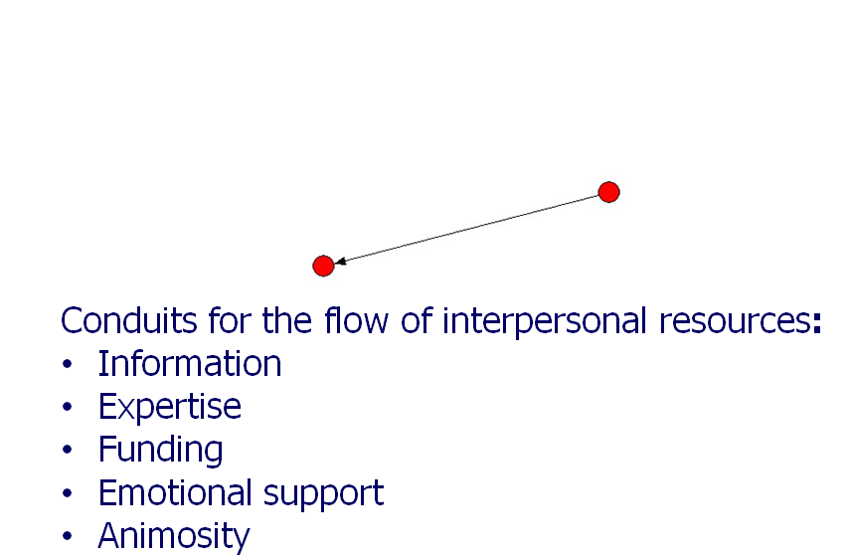
Networks as a discipline
Social networks are: The web of ties that connect people to each other, in a group, an organization, a community, etc…
“Tie”: Interpersonal relationship between two people
The focus of our survey was (1) instrumental ties, i.e., relationships that facilitate the flow of work-related information and advice, and (2) friendship ties, i.e., relationships that facilitate the exchange of affective resources.

Slide 35
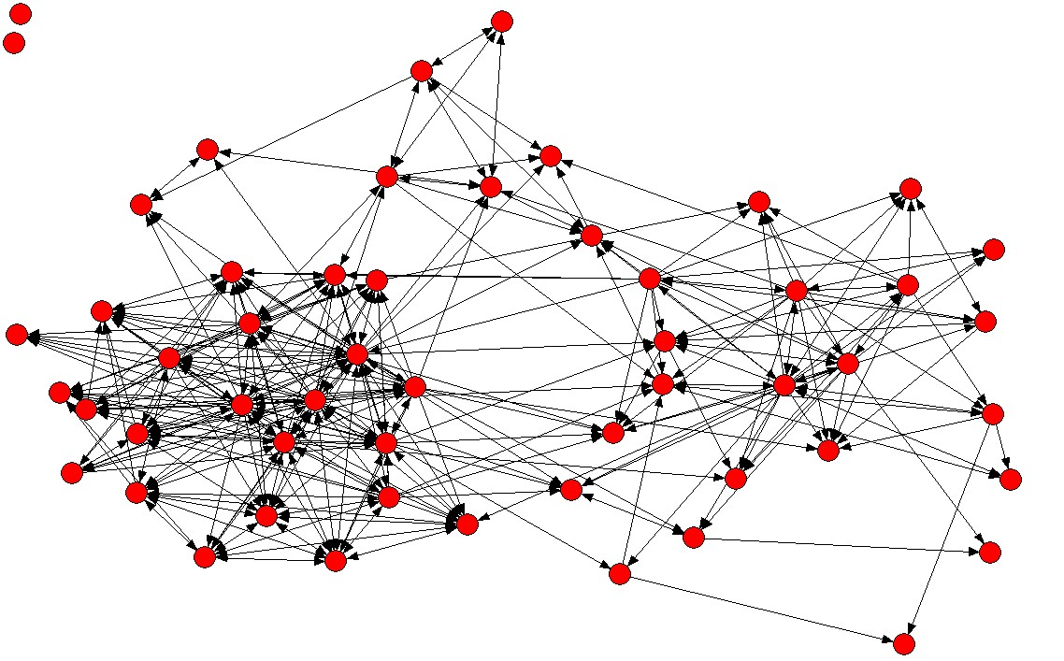
Network: Pattern of interpersonal ties that connect people to each other
Below is a map of a hypothetical network:

Slide 36
The importance of network position
Your “network position” has important implications regarding the flow of work-related resources between you and your colleagues.
For example, consider the three “nodes,” i.e., actors represented as circles, marked on the right. What are the possible strengths and weaknesses of each position?
?
?
?

Slide 37
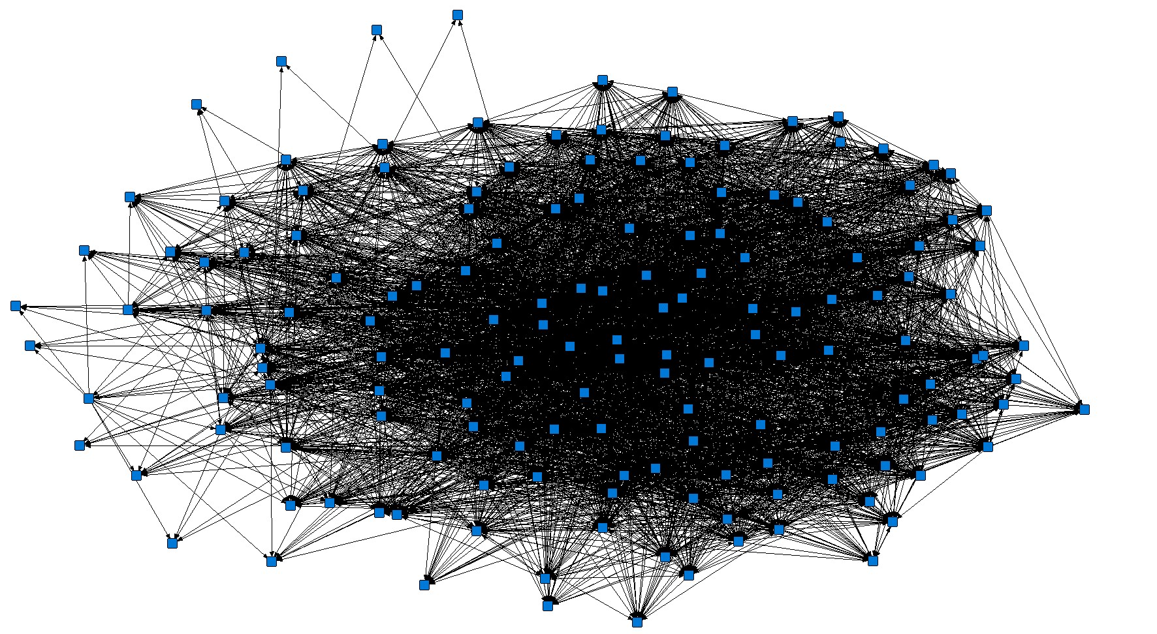
XYZ’s Instrumental Network Structure
As you can see, the network is quite dense, i.e., looks like a “hairball”

Slide 38
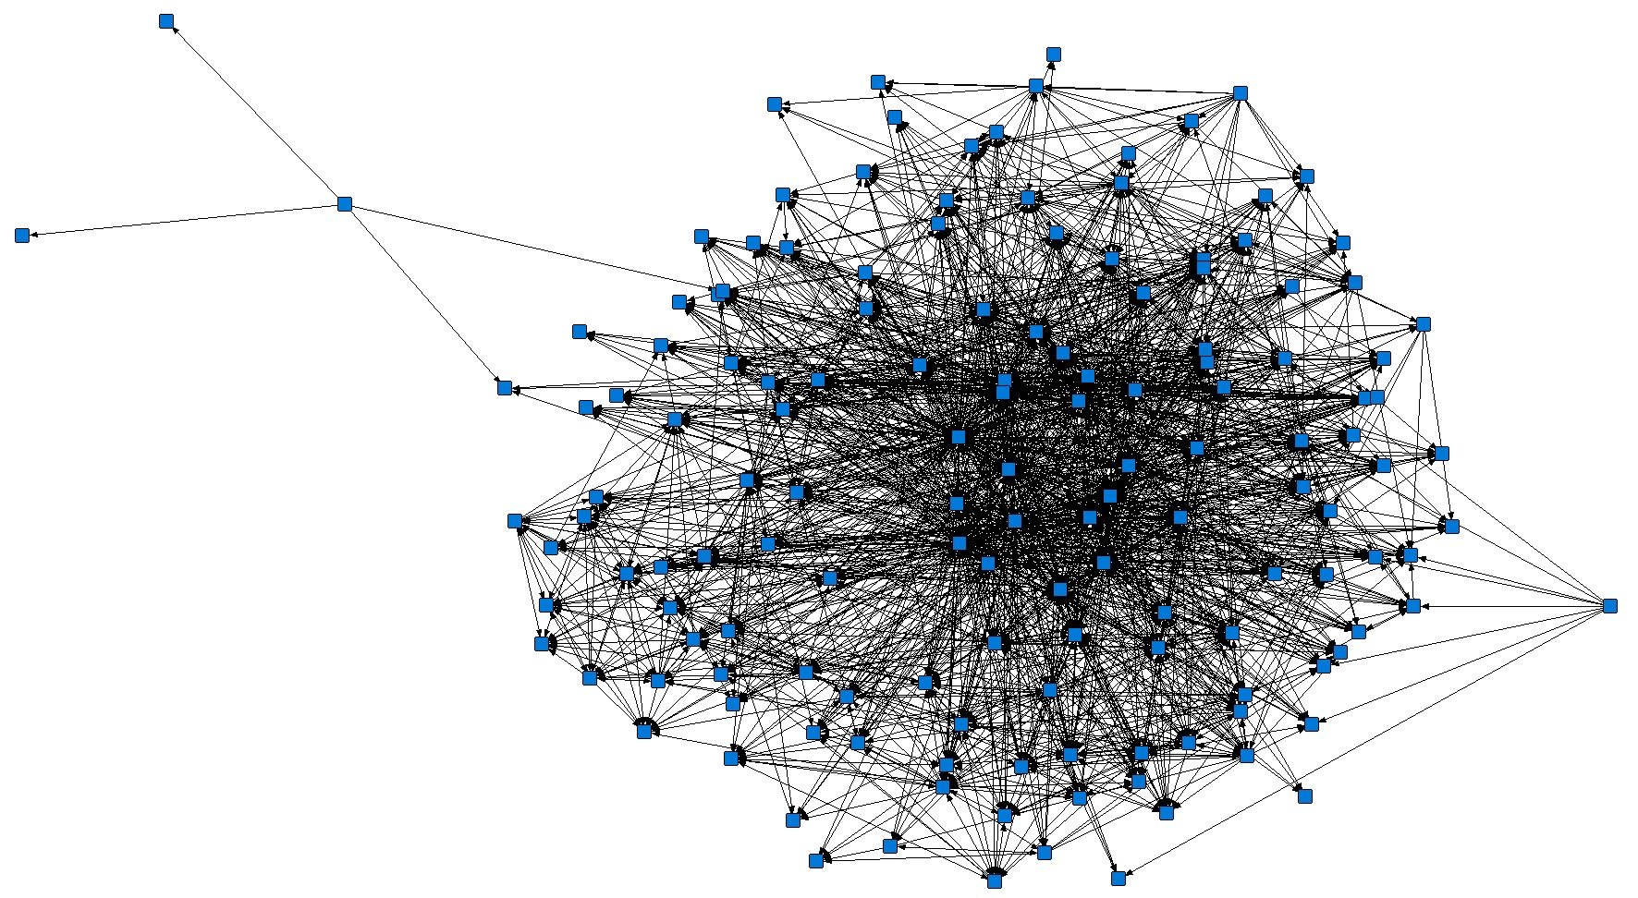
XYZ’s Affective Network Structure

Slide 39
Next, let’s look at the descriptive statistics for each of the computed network metrics

Slide 40
Centrality
What it measures: Centrality is the raw count of the number of persons who reported “you” as a network contact. In-degree centrality measures the number of people who reach out to you for resources, whereas out-degree centrality measures the number of people to whom you reach out for resources.
A
B
Actor A has higher centrality than Actor B

Slide 41
Centrality (cont.)
 |  | In-degree centrality (Instrumental) |  |  | Out-degree centrality (Instrumental) |  |  | Centrality (Affective/Friendship)
Org level | N | Mean | S.D. | Range | Mean | S.D. | Range | Mean | S.D. | Range
Entry | 32 | 41.91 | 13.86 | 4-66 | 62.34 | 34.59 | 1-146 | 16.75 | 7.18 | 0-29
Mid | 78 | 46.58 | 19.31 | 0-113 | 48.38 | 28.21 | 1-145 | 16.04 | 7.01 | 0-32
Senior | 9 | 54.22 | 21.51 | 0-70 | 61.33 | 30.73 | 1-94 | 14.22 | 9.37 | 0-29
Executive | 5 | 46.80 | 17.66 | 31-76 | 46.60 | 34.48 | 22-106 | 8.80 | 2.86 | 5-12
All | 124 | 45.94 | 18.21 | 0-113 | 52.85 | 30.70 | 1-146 | 15.80 | 7.22 | 0-32
ANOVA reveals no significant differences in any of the three centrality scores across org levels.
However, friendship centrality has significant, negative correlations with self-reported power (r = -.22, p < .05) and status (r = -.25, p < .01).
Instrumental out-degree centrality has a significant and negative correlation with TGO (r = -.22).
Networking behavior has significant and positive correlations with instrumental in-degree (r = .42, p < .01) and out-degree centrality (r = .28, p < .01) and friendship centrality (r = .38, p < .01).

Slide 42
Reach
What it measures: Reach reflects the extent to which an individual, through his/her direct connections, can contact other members of a network. In this study, we computed the 2-step (inbound and outbound) reach, that is, what percentage of the entire network one can reach within 2 steps (e.g., “friend of a friend”).
Inbound reach thus reflects the breadth of information that can flow into you in 2 steps or less, whereas outbound reach reflects how far you can disseminate information in 2 steps or less.
B
A
Low reach
High reach

Slide 43
Reach (cont.)
 |  | Inbound reach (instrumental) |  |  | Outbound reach (instrumental)
Org level | N | Mean | S.D. | Range | Mean | S.D. | Range
Entry level | 32 | 99.92 | 0.46 | 97.4-100 | 96.77 | 12.21 | 30.3-100
Mid level | 78 | 97.44 | 15.91 | 0-100 | 96.64 | 4.89 | 60.7-100
Senior level | 9 | 88.60 | 33.24 | 0-100 | 92.97 | 16.29 | 49.7-100
Executive level | 5 | 99.48 | 1.15 | 97.4-100 | 97.42 | 1.58 | 96.1-100
All | 124 | 97.52 | 15.42 | 0-100 | 96.44 | 8.42 | 30.3-100
ANOVA reveals no significant differences in inbound or outbound reach across org levels.
Inbound reach has a significant and positive correlation with self-interest orientation (r = .18, p < .05).
Outbound reach has a significant and negative correlation with TGO (r = -.44, p < .01).

Slide 44
Density
What it measures: Density reflects the degree to which the people you’re connected to are connected amongst themselves. It ranges from 0 (zero closure) to 100 (full closure).
Both dense and sparse (personal) networks are beneficial for different reasons. The key is “striking a balance.”
Benefits of dense personal networks (see Bill’s network)
Greater trust and socio-emotional support
Ease of coordination
Transfer of complex, tacit, sensitive knowledge
Stability, reliability of access to idiosyncratic resources
Reputational effects are stronger
Bill
Benefits of sparse personal networks (see Sue’s network)
Access to non-redundant information
Access to entrepreneurial opportunities
Flexibility, mobility
Control of information and resources
Relative freedom from reputation effects
Sue

Slide 45
Density (cont.)
 |  | Instrumental network density (in-bound) |  |  | Friendship network density
Org level | N | Mean | S.D. | Range | Mean | S.D. | Range
Entry | 32 | 45.49 | 9.05 | 26.1 – 66.7 | 40.94 | 16.58 | 0 – 84.7
Mid | 78 | 48.28 | 8.03 | 28.5 – 66.9 | 38.01 | 12.85 | 10.7 – 68.6
Senior | 9 | 41.74 | 6.89 | 30.3 – 53.6 | 36.87 | 20.40 | 0 – 70.3
Executive | 5 | 46.53 | 6.58 | 39.0 – 56.6 | 40.69 | 18.56 | 13.4 – 62.2
All | 124 | 47.01 | 8.31 | 26.1 – 66.9 | 38.79 | 14.59 | 0 – 84.7
ANOVA reveals no significant differences in either density scores across org levels.
Networking behavior is negatively related to density (r = -.27, p < .01 for both networks)
Friendship density has significant, negative correlations with tenure (r = -.19, p < .05) and TIO (r = -.19, p < .01), and a significant, positive correlation with TGO (r = .18, p < .01).

Slide 46
Brokerage
What it measures: Actor A brokers actors B and C if A is connected to both B and C, but B and C are not connected. In this study, we computed brokerage as the extent to which your personal contacts must “go through” you in order to reach others (i.e., you lie in the shortest path between X and Y, meaning X must go through you to reach Y).
Conceptually, it is more-or-less an “inverse” of density.
Brokerage ranges from 0 (i.e., 0% of pairs in your network must go “through you” to reach each other as quickly as possible) to 1 (i.e., 100% of pairs in your network must go “through you” to reach each other as quickly as possible).
Occupying brokerage positions is strategically advantageous, because brokers are able to control the flow of resources, and is the center point of innovation and idea creation.

Slide 47
Brokerage (cont.)
Brokerage in one’s personal instrumental network
Org level | N | Mean | S.D. | Range
Entry level | 32 | 0.18 | 0.03 | 0.10 – 0.24
Mid level | 78 | 0.20 | 0.05 | 0.00 – 0.31
Senior level | 9 | 0.21 | 0.08 | 0.00 – 0.25
Executive level | 5 | 0.21 | 0.03 | 0.18 – 0.27
All | 124 | 0.20 | 0.05 | 0.00 – 0.31
ANOVA reveals no significant differences in brokerage scores across org levels.
Brokerage has significant and positive correlations with networking behavior (r = .34, p < .01), self-perceived status (r = .24, p < .01), and TCO (r = .25, p < .01).

Slide 48
Key takeaways II (centrality, reach, density, and brokerage)
“Why examine networks?”
Social network metrics describe (and reveal patterns among) social relations that facilitate knowledge sharing and collaboration.
For example, in instrumental networks, centrality and reach is indicative of the amount and breadth of information that flows in and out of you.
Dense personal networks can be effective at facilitating tacit and sensitive knowledge, forming interpersonal trust, and coordinating group activities.
On the other hand, sparse personal networks enable one to potentially occupy powerful brokerage positions that allow strategic control of the flow of resources between other people.

Slide 49
Key takeaways II: Centrality, reach, density, and brokerage (cont.)
Data revealed that:
People who engage in more networking behavior tended to score higher on centrality (in both instrumental and friendship networks) and brokerage, but lower on density.
It is likely that people who actively “network” frequently form new relationships with people outside of their pre-existing personal networks and are thus able to acquire more brokerage positions.
Individuals with higher power and status tended to be less central in the friendship network.
People with higher power and status may be at greater risk of social isolation, despite being “instrumentally” well-connected. Perhaps other people often overlook the friendship value of individuals possessing higher power and status or are intimidated by them.
In particular, multiple regression analysis reveals that status negatively predicts friendship centrality after controlling for tenure and the psychological factors of self-interest and other-interest orientations.
Status → Friendship centrality: Β = -.26 (p < .01); F = 2.49 (p < .05); R² = .08, ΔR² = .06 (p < .01)

Slide 50
Key takeaways II: Centrality, reach, density, and brokerage (cont.)
Data revealed that:
Self-interest orientation is positively related to inbound reach in the instrumental network.
It suggests that people recognize inbound reach, i.e., the breadth of information flowing into you in 2 steps or less, as being important to accomplishing their work-related goals, interests, and desires, and may thus be spurred to form relationships with people who are well-connected themselves.
Status and tertius conduit orientation (TCO), i.e., tendency to “channel” resources between people, are positively related to brokerage in the instrumental network.
These relationships were also significant after controlling for organizational level and tenure.
Status → Brokerage: Β = .21 (p < .05); F = 3.03 (p < .05); R² = .07, ΔR² = .04 (p < .05)
TCO → Brokerage: Β = .22 (p < .05); F = 3.45 (p < .05); R² = .08, ΔR² = .05 (p < .05)
Perhaps status attracts diverse clusters of people in an instrumental network, leading to brokerage.
People with high TCO may acquire more brokerage positions through “channeling resources” between diverse clusters of people.

Slide 51
Thank you for listening!

